Slide 1
Big Blue Parking Genie
An asynchronous, modern, web-based take on parking asset management
Group 8:
Logan Smith: Developer
Austin Reeve: Senior Front-End Developer
Cole Webb: Designer, Scrum Master
Jeremy Young: API Engineer

Slide 2
Overview
Big Blue Parking Genie is an asynchronous parking asset management system built on top of modern web technology. This technology consists primarily of React on the front-end and Django on the back-end.
React was chosen primarily due to our senior developer’s familiarity with it. As you will see later in the presentation, this was well-considered.
Django was chosen due to Python’s strength in string processing, which positions it well to provide internal APIs. We later extended its use to include providing administration interfaces.
The choice was made early to entirely decouple React from the backend and use Django to provide APIs for its usage. Once the API outputs were designed, work could commence on the front-end without waiting on the APIs.
Django eventually came into use to provide static administration pages, a robust database back-end, form handling and user management.

Slide 3
Agile Practices
Scrum prescribes a frequent standup meeting. Shortly after the end of the first sprint, it became clear that we needed to meet more often, but didn’t have the schedule unity to do so traditionally. Austin proposed a standup channel in Slack, which allowed us to communicate about our progress asynchronously. This led to a considerable improvement in productivity, as it allowed us to work when we had time and worry less about making meetings.
Agile emphasizes having usable software early in the development process. We accomplished this by focusing our efforts, at least initially, on getting the customer interface ready. Of the four user interfaces created, the customer interface was the most critical, and the only interface that the user pays to use rather than being paid to use, so it was our first priority.
Finally, our team self-organized. No one was assigned work. Rather we each picked our work based on personal interest and a drive for excellence, and our product reflects that.

Slide 4
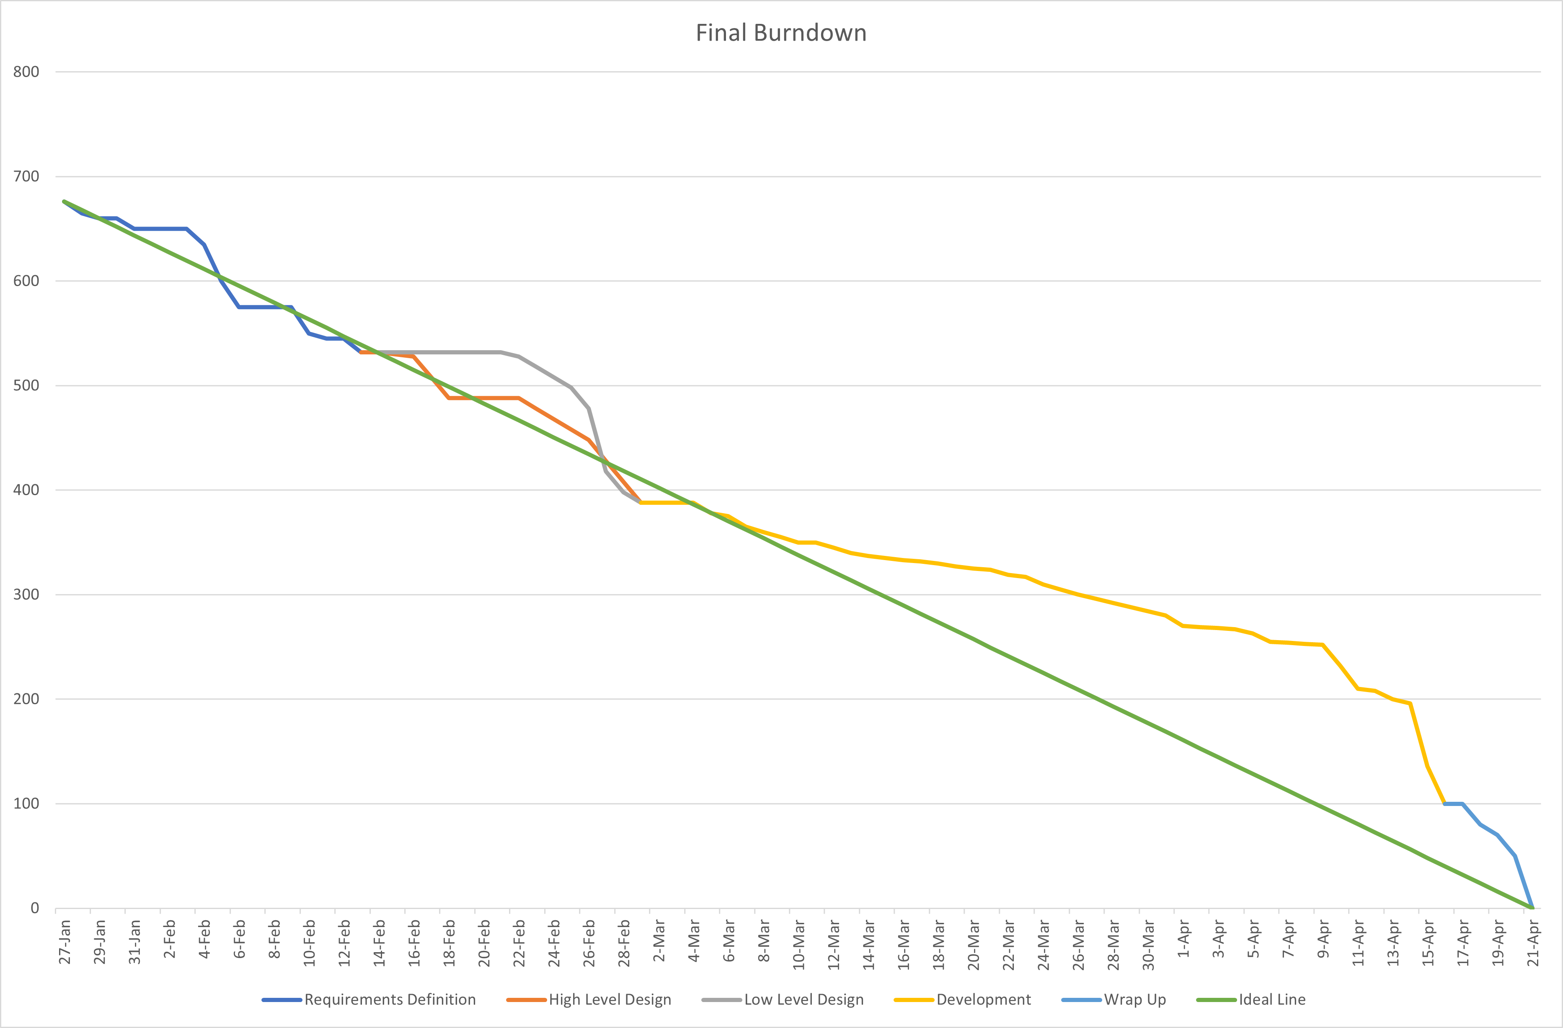
Final Burndown
Velocity
Sprint 1: 1
Sprint 2: 2
Sprint 3: 2
Overall: 6

Slide 5
Deployment Readiness
Explain why the project is ready to move into deployment, including a discussion of the correctness of the code and description of the testing phase.
Our project is ready to move to deployment for the following reasons:
It is secure. No known security issues exist, and every precaution we are aware of has been taken. The principle of least access has been applied, and each user has access only to that which is necessary to complete their tasks.
It is tested and correct. In addition to a unit testing suite, each system and integration has been routinely tested to ensure that it performs its intended function and nothing else. No magic was involved in testing, and each issue has been resolved.
It is powerful. Not only can lot owners post their lots, they can also associate their lots with events and set per-event costs and capacities. Administrators have access to a suite of custom tools for moderating the site and its content, in addition to access to Django’s substantial built-in administration tools.
It is modern. The maps are provided by Google and provide access to on-device deep links, the QR codes are generated by an external API, and React uses the latest JavaScript technology. Further, it would take only minimal effort to include PWA technology for the customer, allowing offline usage and device integration.

Slide 6
FEATURE: Purchase a spot
This feature will allow the user to open the application, select an event from the list, pick a lot, pick a parking spot size and purchase a parking reservation.
Functional – Gives the user a way to purchase a parking spot.
Must – Was a key feature of the application.
This feature started as a design focal point in milestone one, and was iterated on all the way through milestone 4.

Slide 7
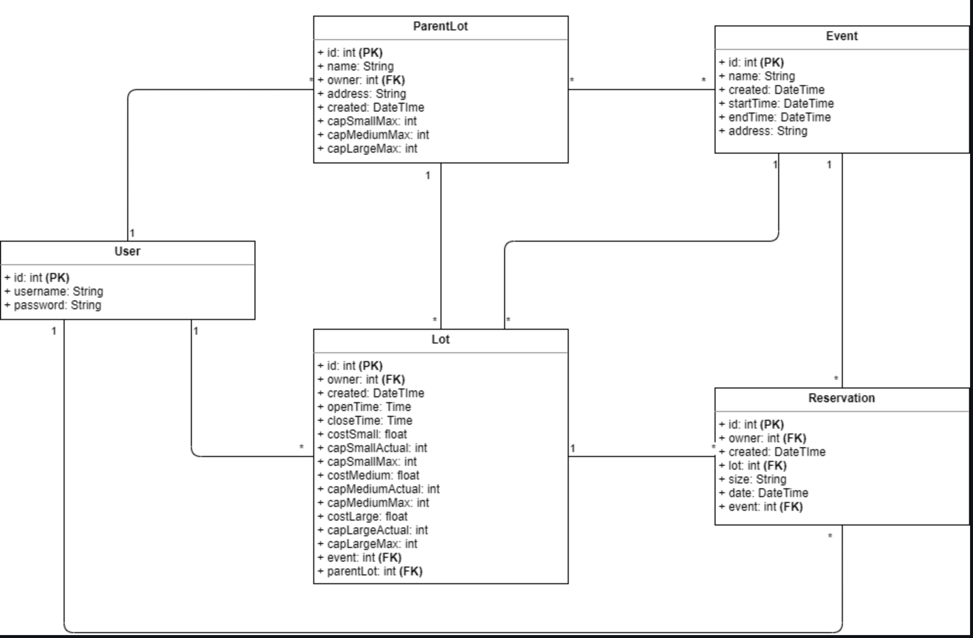
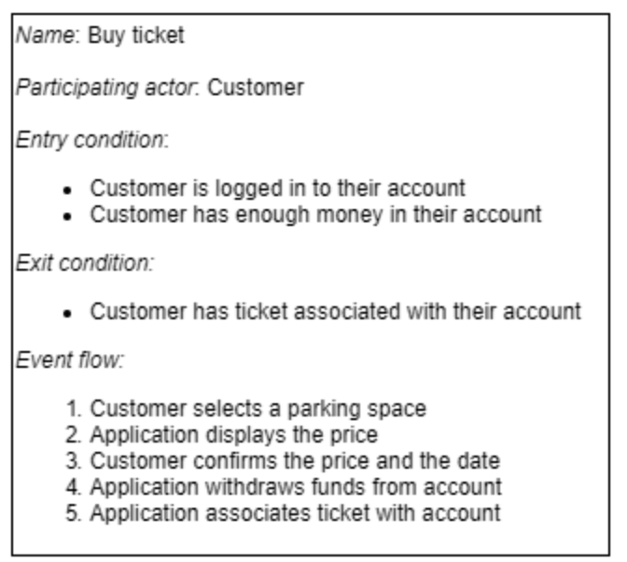
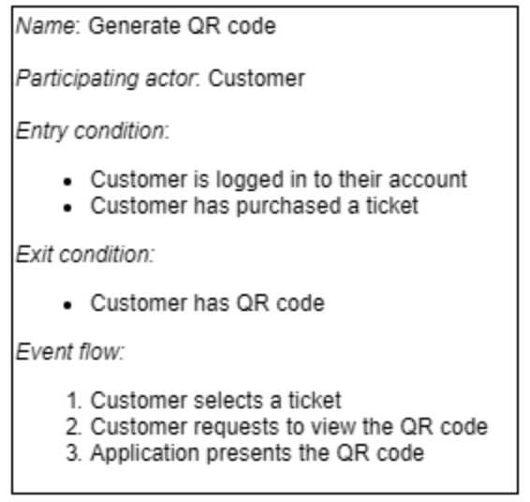
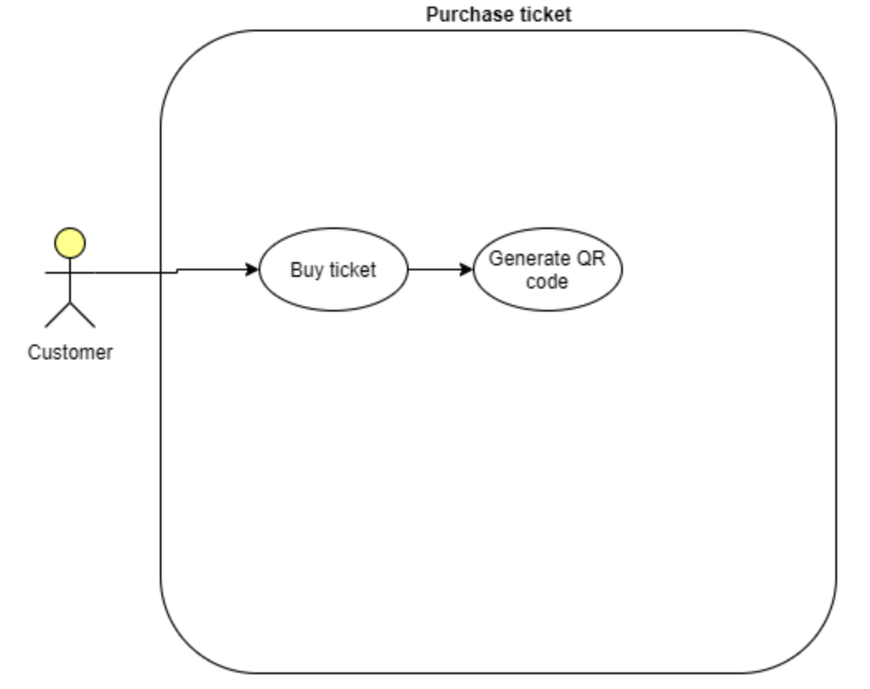
FEATURE: Purchase a spot
Class Diagram:
This is the Use Case Diagram and Class Diagram. Not much was changed from the original plan we created.
Use Case Diagram:

Slide 8
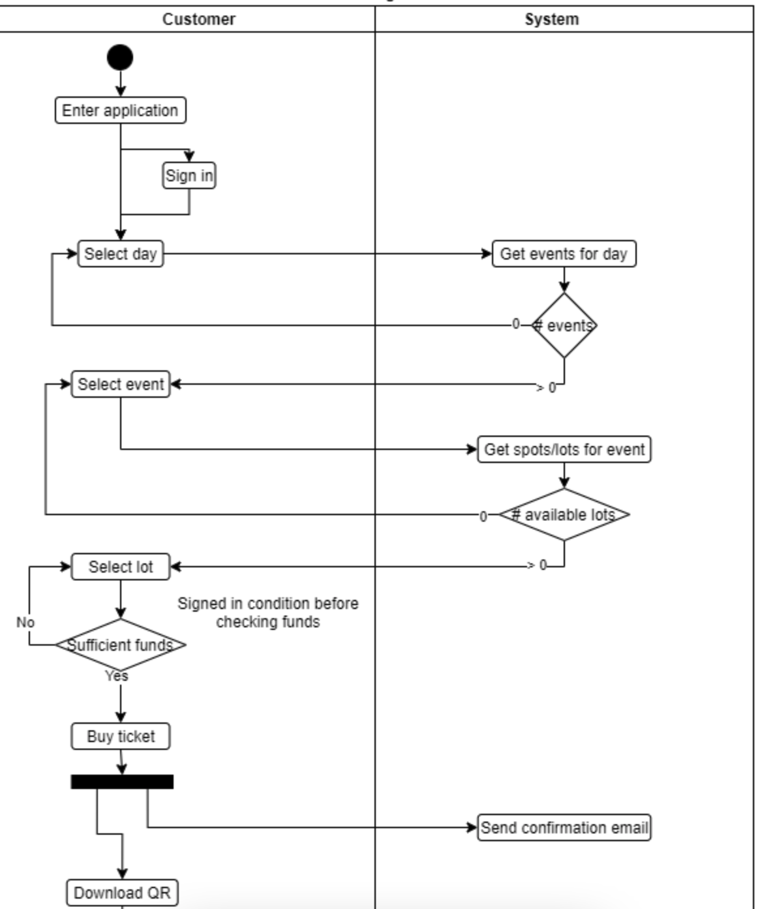
Relevant Tasks/Issues
FEATURE: Purchase a spot
Activity Diagram

Slide 9
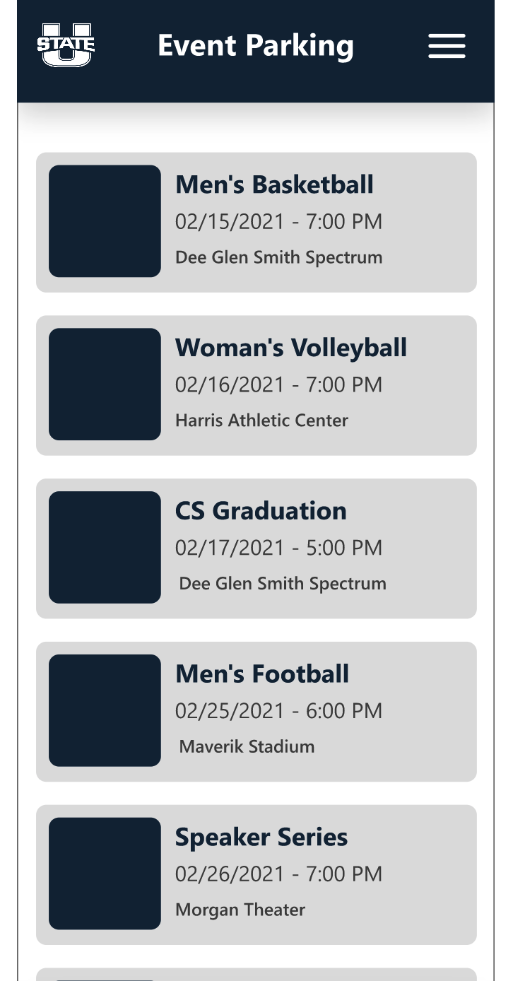
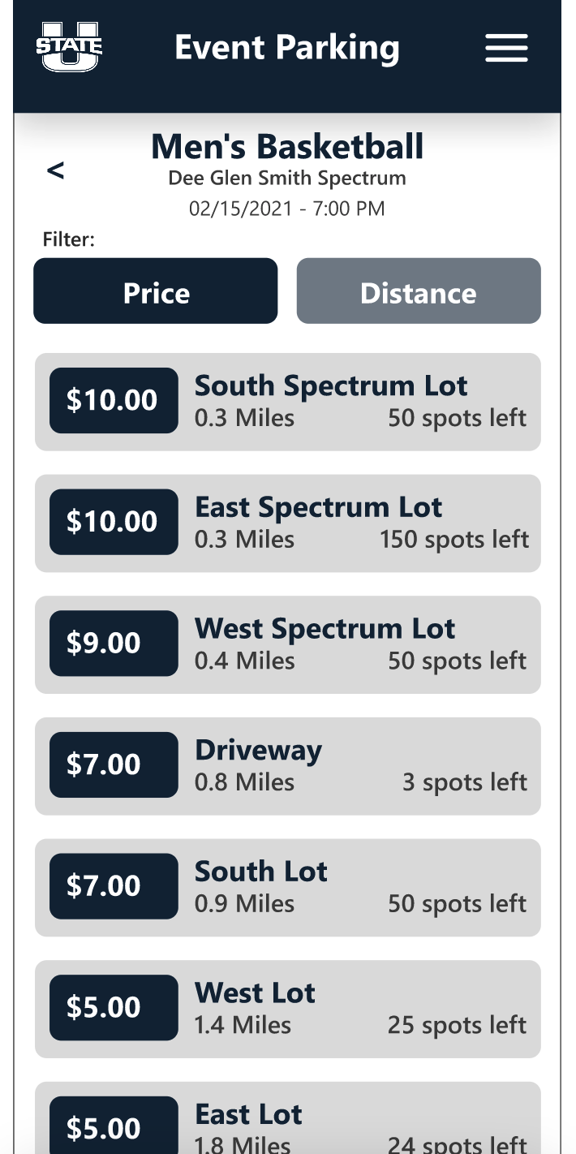
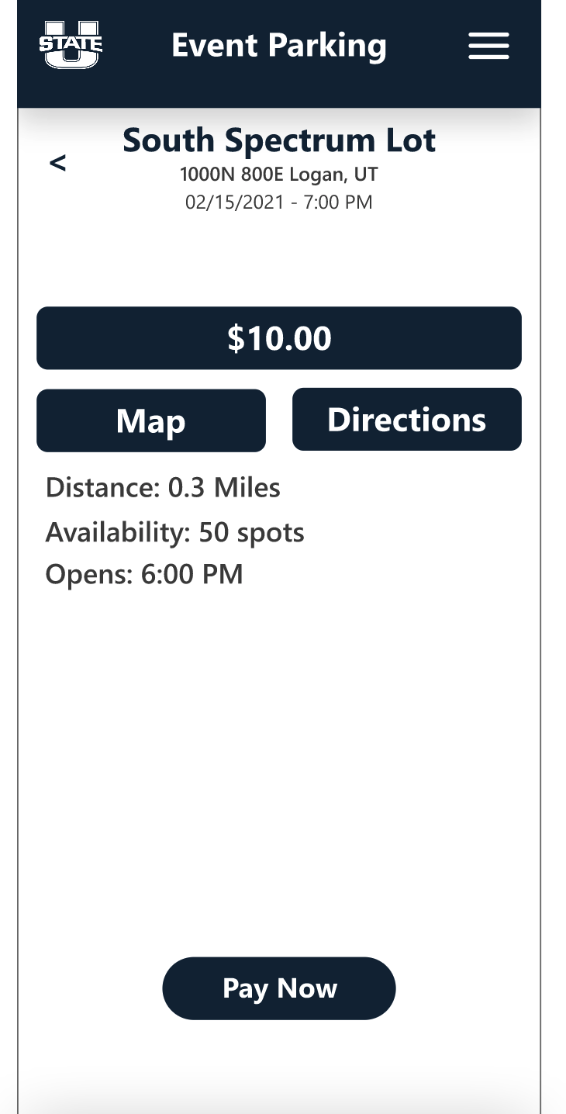
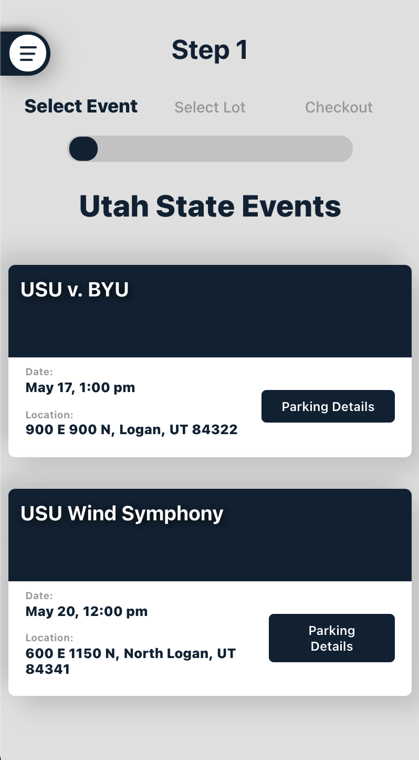
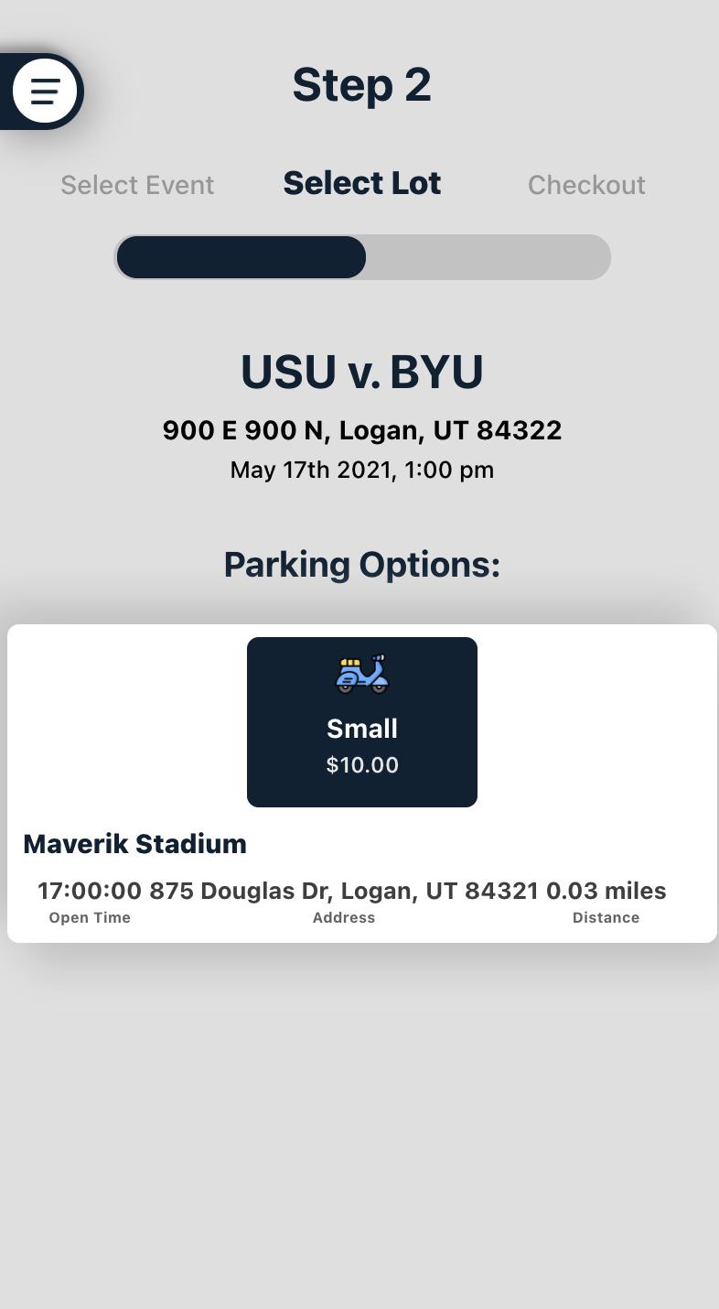
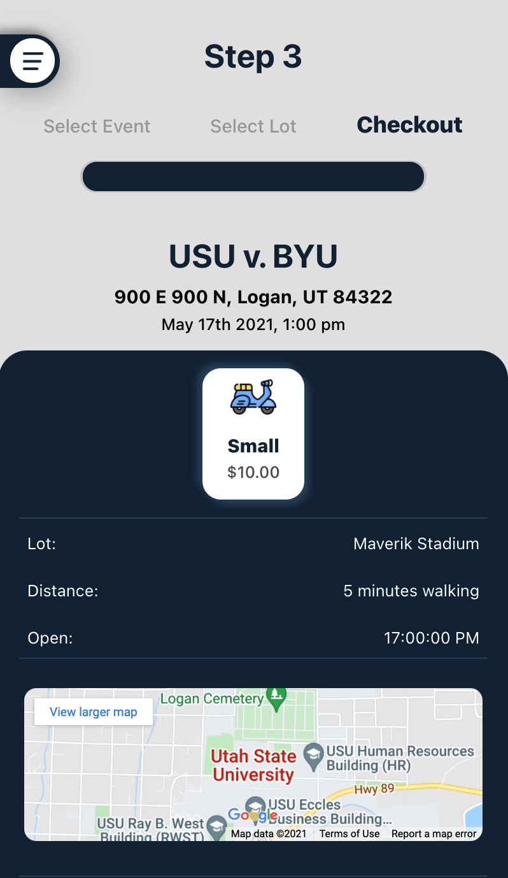
Design Choices
Used react for modern front end
Desktop and mobile friendly
Easy to reach menu that is hidden
List items display important information
Step counter to give user feedback
Map to show user a visual lot location
Icons to select and understand parking spot sizes
High fidelity Prototype
Final Product
Notes:
We moved the menu from the top to the side so it was easier to reach and folded out.
Step counter moves with every new page to show the user where they are and to help them understand that this will be quick Icons help the user understand what size parking spot they will need
Map can be clicked on to show where the lot is located
Date and location are shown on the event

Slide 10
User Balance / Transfer Balance
This feature allows for users to purchase spots with a tracked balance, and for lot owners to be paid for their spots.
Functional - Allows for funds to be tracked and used by users.
Must - This was essential for lot owners and university admin to be able to receive payment.
This was added as a requirement in Milestone 1 and was implemented and finalized during Milestone 4. The user model used in this project was the default user model included with Django, Django REST, and the REST Framework JWT frameworks used. In order to associate a unique balance with each user in the database, a separate Balance model was created with a OneToOneField relationship with a user object, and a value which can be accessed and updated. This allowed each user to have a unique balance that could only be accessed and updated through that user.

Slide 11
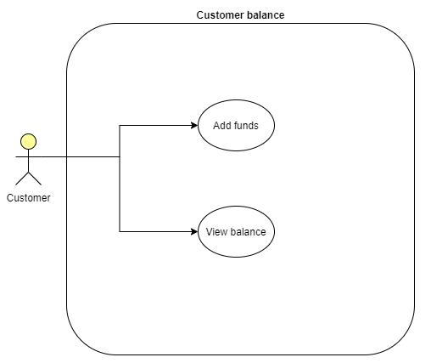
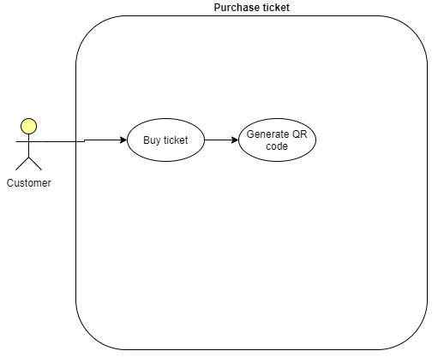
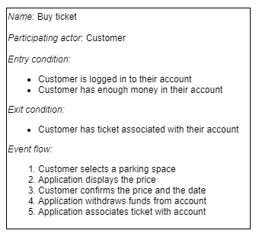
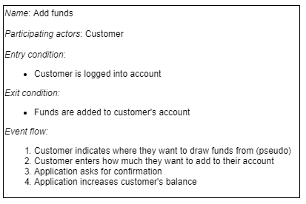
User Balance / Transfer Balance
These are the use-case and class diagrams relating to user balance. They are mostly accurate with the final product. Some parts of the class diagrams are not reflected in the final product because they were not essential features for the project.
Notes:
The parts not included in the final product were having an actual account to withdraw money from, and linking that account to our app. We utilized "play money" where the balances were just numbers. However, this could relatively easily be updated to include this feature.

Slide 12
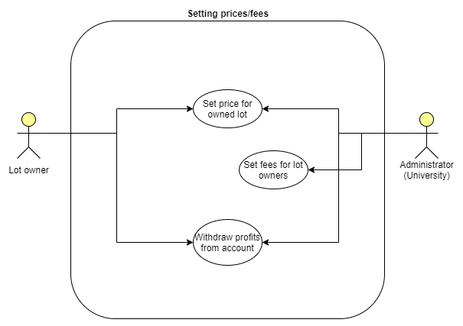
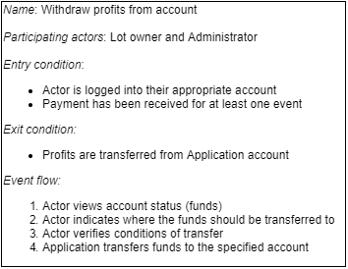
User Balance / Transfer Balance
This use-case diagram and class diagram also outline a use of the balance feature. In the final product, fees aren't actually transferred to a real account, since the project dealt with "play money". However, regular customers do have access to update their balance from their accounts. This was present in prototype 2, though the final product differs from what was seen in the prototype.
Testing:
The features associated with the user balance have been tested multiple times by the developers and have been verified to work as designed. There were no Unit tests associated with this feature, but system tests were done by the developers throughout implementation of this feature.

Slide 13
User Balance / Transfer Balance
Tasks and Issues
This feature was part of Issue #10: User Profile Management, as well as specified in the requirements definition in requirements 3.1.1 and 3.4.3.
Dependencies
This feature depended on the User model to be integrated.
This also depended on the django framework to have been integrated.

Slide 14
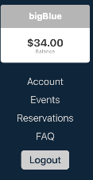
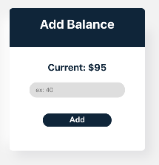
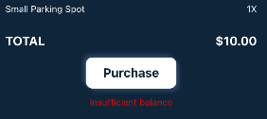
User Balance Design Choices
The users balance will be displayed in the menu side bar below their username. The add balance feature can be accessed from the account page. The total cost of a transaction will be displayed at the end of the checkout screen, and if the user doesn't have sufficient funds, the user will be notified.

Slide 15
Authentication and Permissions
Requirement (1): User authentication and access control (permissions)
Users should be able to log in to an account unique to them and be restricted to performing actions which affect themselves.
Functional – Gives the user a way to identify themselves to the application and ensure their information is secure.
Must – Given its nature, authentication is an integral part of our application.
Authentication development didn’t begin until late into Milestone 3. This is due to needing to have a good application in place onto which we could build authentication.
We heavily utilized djangorestframework_jwt, a dependency that allowed us to easily implement authentication and then customize it to our unique application.
The authentication method we employed is JWT (JSON Web Token). Explained simply, a token will be returned via JSON when a user logs in. Any time the user wants to perform an action involving the database, that token will need to be sent with the request. Tokens are unique to users and expire after a specified amount of time. This is opposed to session authentication, where the authentication information is stored and maintained on the server.

Slide 16
Relevant Tasks/Issues
#9 Authentication and Access Control
#19 Authentication API – Austin Reeve, Jeremy Young
#23 Login API – Austin Reeve, Jeremy Young
#24 Sign up/Register API – Austin Reeve, Jeremy Young
Austin’s work was focused around implementing authentication with the front-end, while Jeremy’s work was focused on implementing authentication into the back-end. Cole also worked on a separate authentication framework for the administration interfaces.

Slide 17
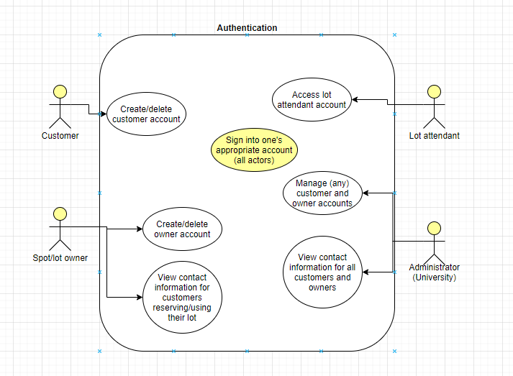
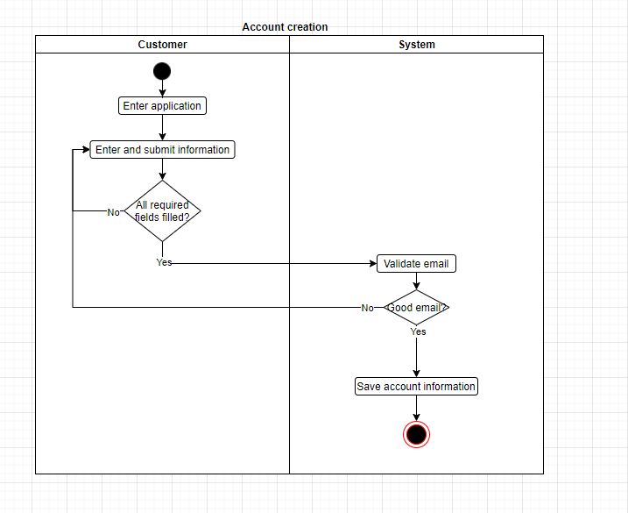
Diagrams:
Note: email validation was never implemented as
Emails are not part of the account creation process

Slide 18
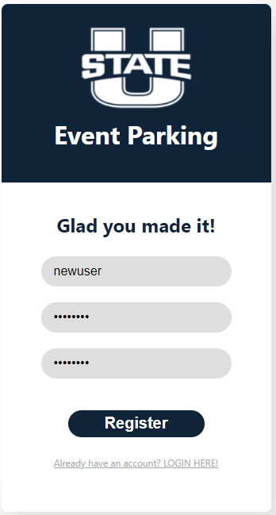
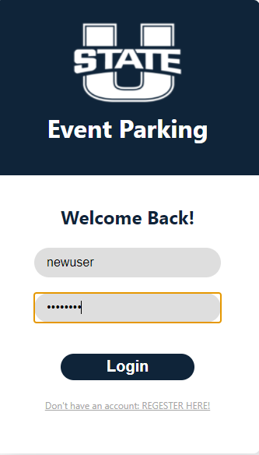
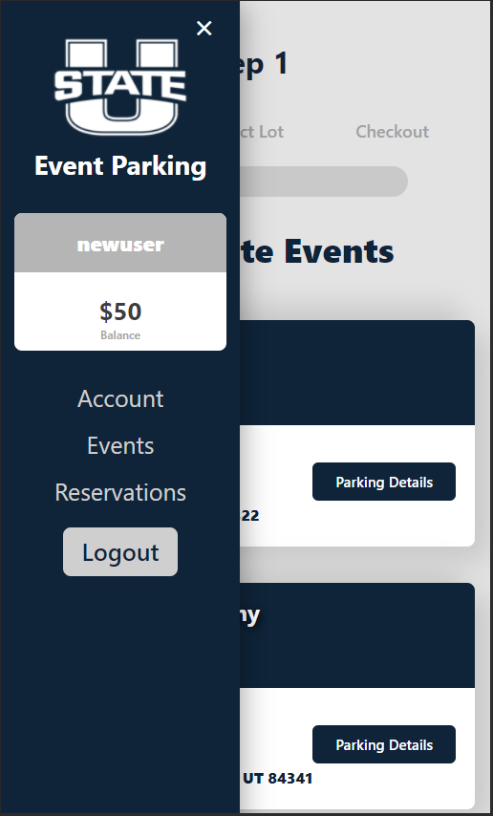
Examples:

Slide 19
Resources
DSF. Django Documentation. Django. (n.d.). https://docs.djangoproject.com/en/3.2/.
Facebook. Getting Started. React. (n.d.). https://reactjs.org/docs/getting-started.html.
Stephens, R. (2015). Beginning software engineering. Wrox, a Wiley brand.
Stack Overflow. Stack Overflow. Stack Overflow. (n.d.). https://stackoverflow.com/.
Christie, T. (n.d.). Django REST Framework. Home - Django REST framework. https://www.django-rest-framework.org/.

Slide 20
Questions?
For questions about the customer interface, ask Austin.
For questions about development as a whole, we point you to Logan.
For questions about design and the administration interfaces, we recommend talking to Cole.
For questions about the API and the database schema, consider Jeremy.
Thank you!

